Slide 1


Data Mining and Data Warehousing
CSE-4107
Md. Manowarul Islam
Assistant Professor, Dept. of CSE
Jagannath University

Slide 2

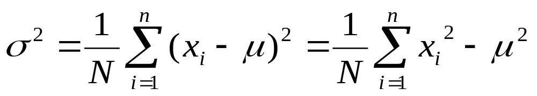
Measuring the Dispersion of Data
Quartiles, outliers and boxplots
  Quartiles: Q₁ (25th percentile), Q₃ (75th percentile)
  Inter-quartile range: IQR = Q₃ – Q₁
  Five number summary: min, Q₁, M, Q₃, max
  Boxplot: ends of the box are the quartiles, median is marked, whiskers, and plot outlier individually
  Outlier: usually, a value higher/lower than 1.5 x IQR
Variance and standard deviation (sample: s, population: σ)
  Variance: (algebraic, scalable computation)
  Standard deviation s (or σ) is the square root of variance s² ⁽or σ²⁾

Slide 3
Variance and Standard deviation
While the central value of a sample is important, the variations around that value are often equally important.
Recall that variability exists when some values are different from (above or below) the mean.
what is a typical deviation from the mean?
  small values of this typical deviation indicate small variability in the data
  large values of this typical deviation indicate large variability in the data

Slide 4

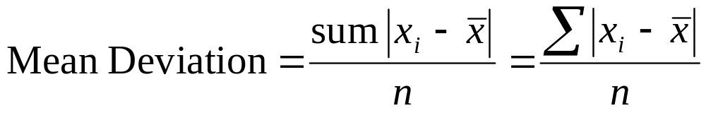
Variance and Standard deviation
Each data value has an associated deviation from the mean:
The Mean Deviation is a measure of dispersion which calculates
  distance between each data point and the mean
  finds the average of these distances.

Slide 5
Variance and Standard deviation
Variance is the average squared deviation from the mean of a set of data.
It is used to find the standard deviation.
  Population variance
  Sample variance

Slide 6
Calculating Variance
1. Find the mean of the data.
Hint – mean is the average so add up the values and divide by the number of items.
Subtract the mean from each value – the
result is called the deviation from the mean.
3. Square each deviation of the mean.
4. Find the sum of the squares.
5. Divide the total by the number of items.

Slide 7
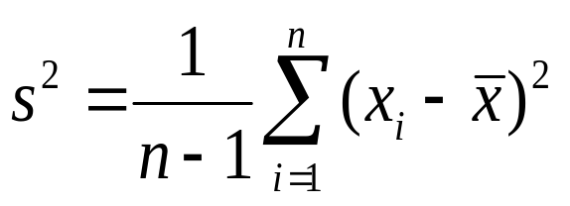
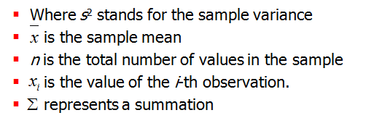
Variance and Standard deviation
The sample variance is defined as follows:

Slide 8
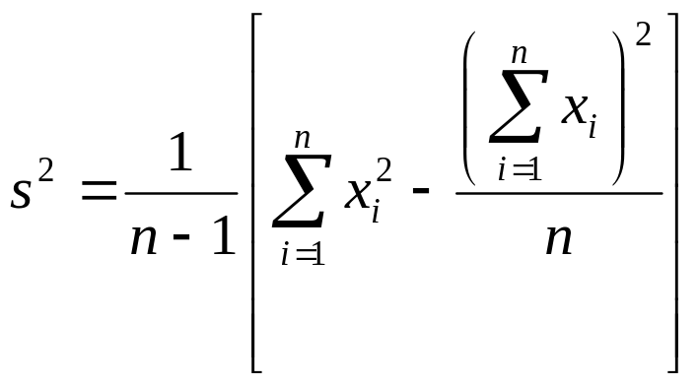
Variance and Standard deviation
The short-cut sample variance is defined as follows:

Slide 9

Variance and Standard deviation
The population variance is defined as follows:
  Where σ² is called the variance of the population
  Mean is represented by

Slide 10
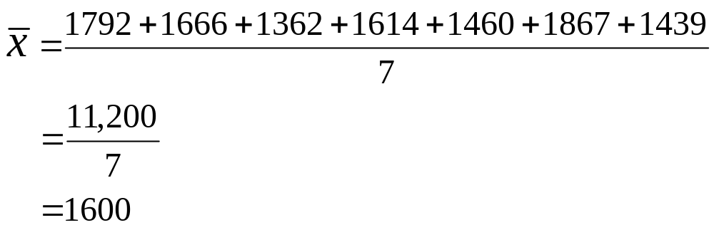
Variance and Standard Deviation
Metabolic rates of 7 men (cal./24hr.) :
1792 1666 1362 1614 1460 1867 1439
Notes:
Basic Practice of Statistics - 3rd Edition
Chapter 2

Slide 11

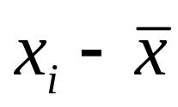
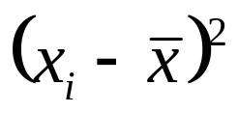
Variance and Standard Deviation
Observations | Deviations | Squared deviations
1792 | 1792−1600 = 192 | (192)² = 36,864
1666 | 1666 −1600 = 66 | (66)² = 4,356
1362 | 1362 −1600 = -238 | (-238)² = 56,644
1614 | 1614 −1600 = 14 | (14)² = 196
1460 | 1460 −1600 = -140 | (-140)² = 19,600
1867 | 1867 −1600 = 267 | (267)² = 71,289
1439 | 1439 −1600 = -161 | (-161)² = 25,921
 | sum = 0 | sum = 214,870
Notes:
Basic Practice of Statistics - 3rd Edition
Chapter 2

Slide 12
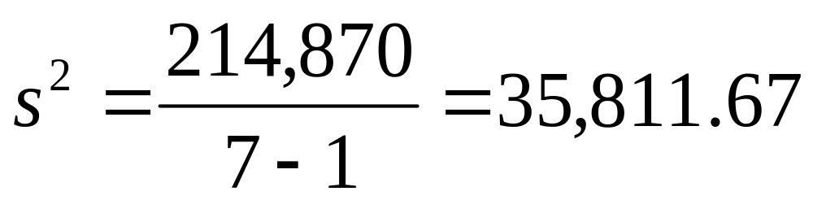
Variance and Standard Deviation
Notes:
Basic Practice of Statistics - 3rd Edition
Chapter 2

Slide 13
Variance and Standard deviation
The standard deviation is the positive square root of the variance:
  Population standard deviation
  Sample standard deviation
If the data is close together, the standard deviation will be small.
If the data is spread out, the standard deviation will be large.

Slide 14
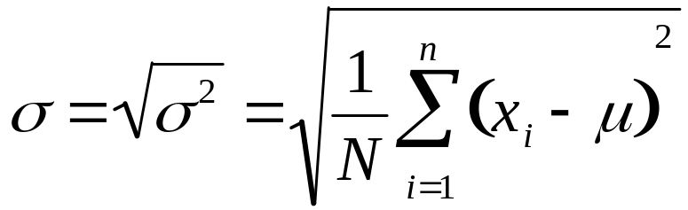
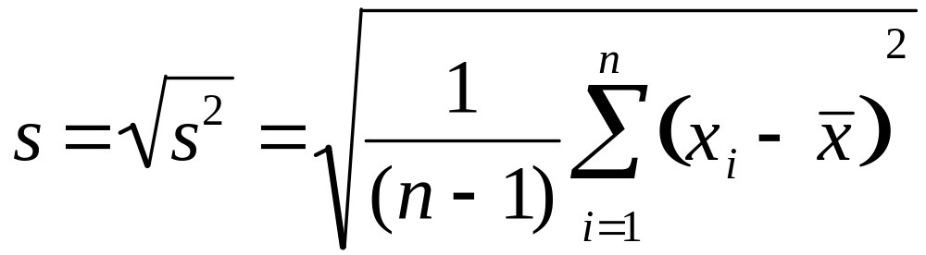
Variance and Standard deviation
Standard deviation of the population.
Standard deviation of the sample

Slide 15
Standard deviation
Find the mean of the data.
Subtract the mean from each value.
Square each deviation of the mean.
Find the sum of the squares.
Divide the total by the number of items.
Take the square root of the variance.

Slide 16
Variance and Standard Deviation
Metabolic rates of 7 men (cal./24hr.) :
1792 1666 1362 1614 1460 1867 1439
Notes:
Basic Practice of Statistics - 3rd Edition
Chapter 2

Slide 17
Variance and Standard Deviation
Observations | Deviations | Squared deviations
1792 | 1792−1600 = 192 | (192)² = 36,864
1666 | 1666 −1600 = 66 | (66)² = 4,356
1362 | 1362 −1600 = -238 | (-238)² = 56,644
1614 | 1614 −1600 = 14 | (14)² = 196
1460 | 1460 −1600 = -140 | (-140)² = 19,600
1867 | 1867 −1600 = 267 | (267)² = 71,289
1439 | 1439 −1600 = -161 | (-161)² = 25,921
 | sum = 0 | sum = 214,870
Notes:
Basic Practice of Statistics - 3rd Edition
Chapter 2

Slide 18
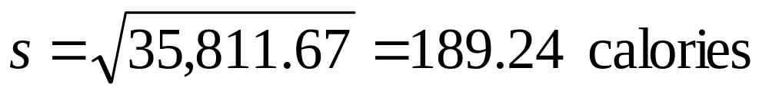
Variance and Standard Deviation
Notes:
Basic Practice of Statistics - 3rd Edition
Chapter 2

Slide 19
Variance and Standard Deviation
The math test scores of five students are: 92,88,80,68 and 52.
1) Find the mean: (92+88+80+68+52)/5 = 76.
2) Find the deviation from the mean:
92-76=16
88-76=12
80-76=4
68-76= -8
52-76= -24

Slide 20
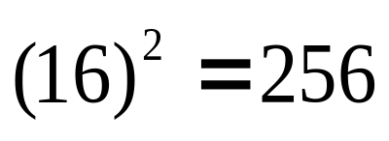
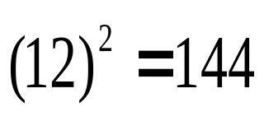
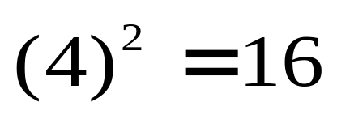
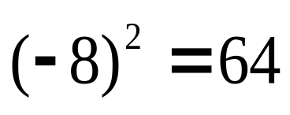
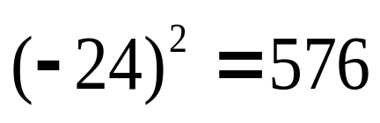
Variance and Standard Deviation
3) Square the deviation from the mean:
4) Find the sum of the squares of the deviation from the mean:
256+144+16+64+576= 1056

Slide 21
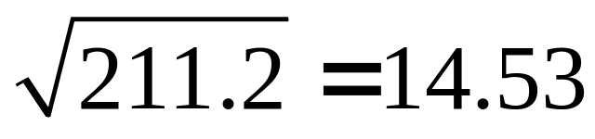
Variance and Standard Deviation
5) Divide by the number of data items to find the variance:
1056/5 = 211.2
6) Find the square root of the variance:
Thus the standard deviation of the test scores is 14.53.

Slide 22
Variance and Standard deviation
Empirical Rule
  If the data has a bell shaped (normal) distribution then Chebyshev’s theorem can be improved.
  The proportion (or fraction) of any data set lying
    Within 1 standard deviation of the mean is about 68%.
    Within 2 standard deviations of the mean is about 95%.
    Within 3 standard deviations of the mean is about 99.7%.

Slide 23
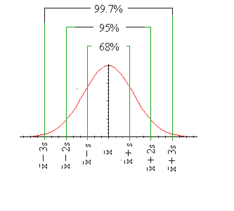
Variance and Standard deviation

Slide 24
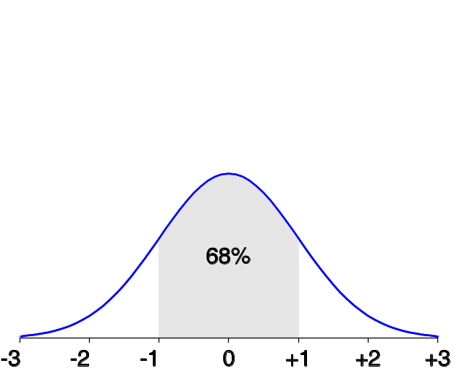
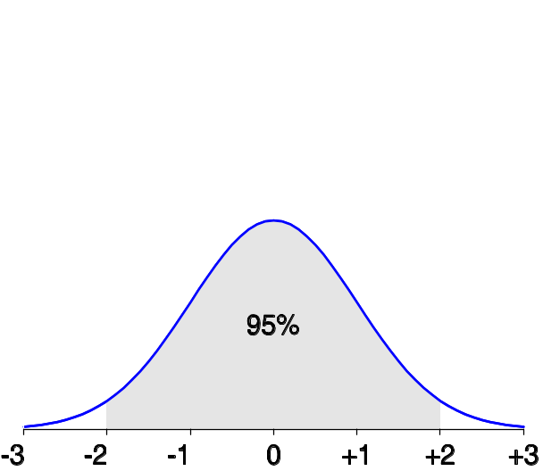
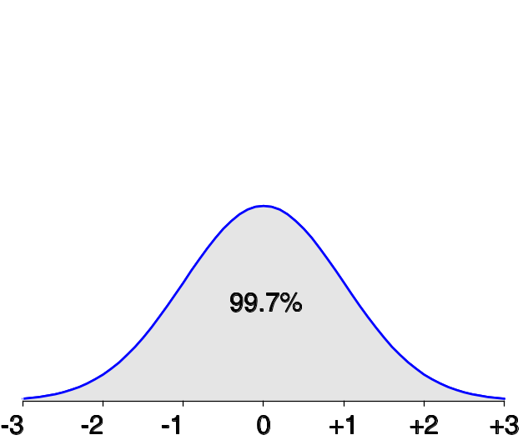
Properties of Normal Distribution Curve
The normal (distribution) curve
  From μ–σ to μ+σ: contains about 68% of the measurements (μ: mean, σ: standard deviation)
  From μ–2σ to μ+2σ: contains about 95% of it
  From μ–3σ to μ+3σ: contains about 99.7% of it

Slide 25
Symmetrical vs. Skewed Frequency Distributions
Symmetrical distribution
  Approximately equal numbers of observations above and below the middle
Skewed distribution
  One side is more spread out that the other, like a tail
  Direction of the skew
    Positive or negative (right or left)
    Side with the fewer scores
    Side that looks like a tail

Slide 26
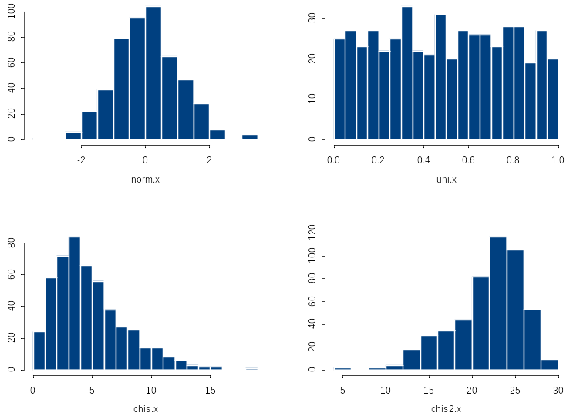
Symmetrical vs. Skewed
Symmetric
Skewed Right
Skewed Left

Slide 27
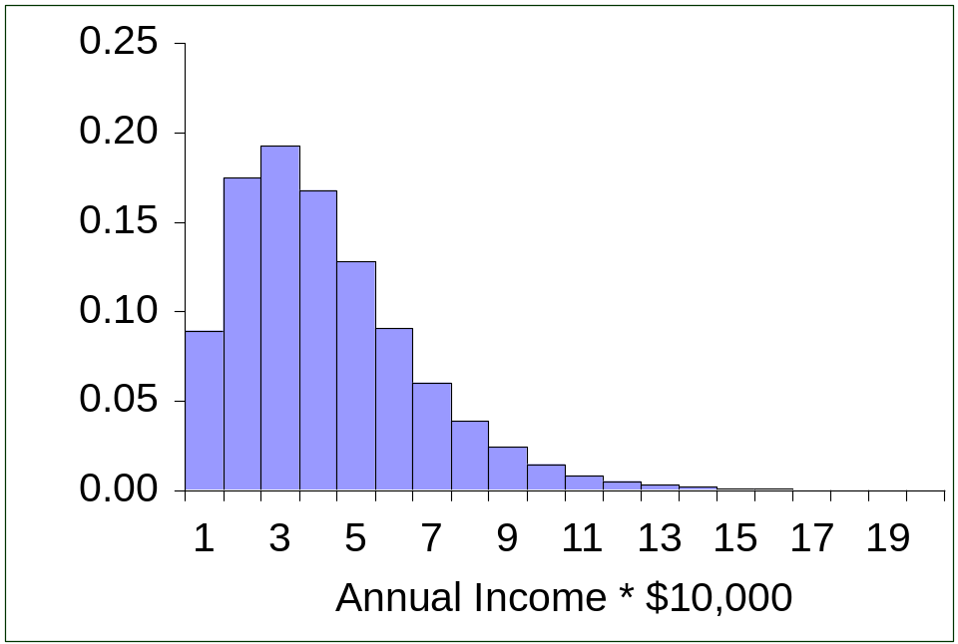
Skewed Frequency Distributions
Positively skewed
  Tail trails to the right
  *** The skew describes the skinny end ***

Slide 28
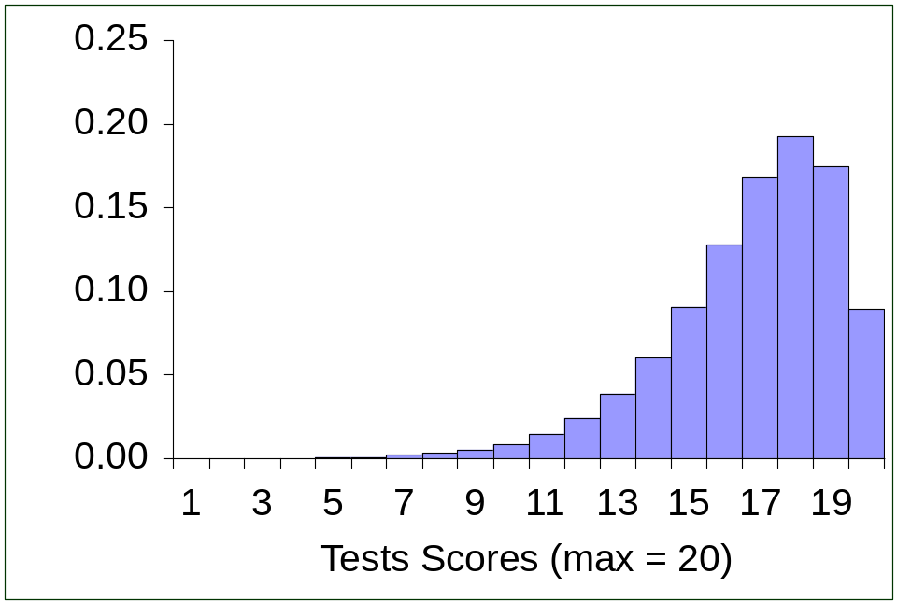
Skewed Frequency Distributions
Negatively skewed
  Skewed left
  Tail trails to the left

Slide 29



Symmetric vs. Skewed Data
Median, mean and mode of symmetric, positively and negatively skewed data

Slide 30
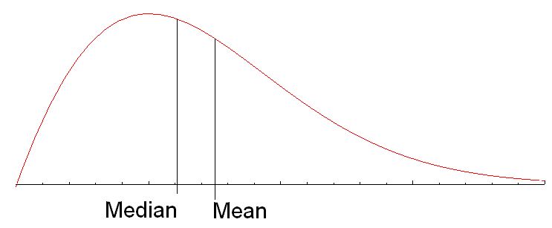
Data Skewed Right
Here we see that the data is skewed to the right and the position of the Mean is to the right of the Median.
  One may surmise that there is data that is tending to spread the data out at the high end, thereby affecting the value of the mean.

Slide 31
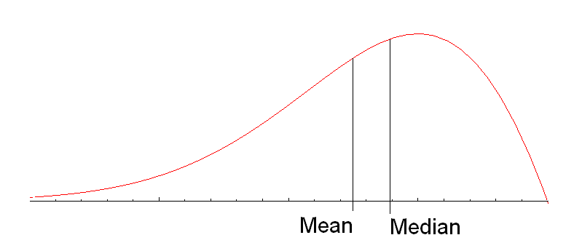
Data Skewed left
Here we see that the data is skewed to the left and the position of the Mean is to the left of the Median.
  One may surmise that there is data that is tending to spread the data out at the low end, thereby affecting the value of the mean.

Slide 32
Summary Measures
Describing Data Numerically
Central Tendency
Quartiles
Variation
Shape
Arithmetic Mean
Range
Skewness
Median
Interquartile Range
Mode
Variance
Geometric Mean
Standard Deviation
Coefficient of Variation

Slide 33
Chapter 2: Data Preprocessing
Why preprocess the data?
Descriptive data summarization
Data cleaning
Data integration and transformation
Data reduction
Discretization and concept hierarchy generation
Summary

Slide 34
Why Data Preprocessing?
Data in the real world is dirty
  incomplete:
    lacking attribute values
    lacking certain attributes of interest
    containing only aggregate data
    e.g., occupation=“ ”
  noisy:
    containing errors or outliers- e.g., Salary=“-10”
  inconsistent:
    containing discrepancies in codes or names- e.g., Age=“42” Birthday=“03/07/1997”
No quality data, no quality mining results!
  Quality decisions must be based on quality data
  Data warehouse needs consistent integration of quality data

Slide 35
Major Tasks in Data Preprocessing
I. Data cleaning
  fill in missing values
  smooth noisy data
  identify or remove outliers
  resolve inconsistencies
II. Data integration
  Integration of multiple databases, data cubes, or files
III. Data transformation
  Normalization and aggregation

Slide 36
Major Tasks in Data Preprocessing (cont)
IV. Data reduction
  Obtains reduced representation in volume but produces the same or similar analytical results
V. Data discretization
  Part of data reduction but with particular importance, especially for numerical data

Slide 37

Forms of Data Preprocessing

Slide 38
Data Cleaning
Importance
  “Data cleaning is one of the three biggest problems in data warehousing”—Ralph Kimball
  “Data cleaning is the number one problem in data warehousing”—DCI survey
Data cleaning tasks
  Fill in missing values
  Identify outliers and smooth out noisy data
  Correct inconsistent data
  Resolve redundancy caused by data integration

Slide 39
How to Handle Missing Data?
Ignore the tuple: usually done when class label is missing (assuming the tasks in classification—not effective when the percentage of missing values per attribute varies considerably.
Fill in the missing value manually: tedious + infeasible?
Use a global constant to fill in the missing value: e.g., “unknown”,
Use the attribute mean to fill in the missing value
Use the attribute mean for all samples belonging to the same class to fill in the missing value: smarter

Slide 40
III. Data Transformation : Data Preprocessing
Smoothing: remove noise from data
Aggregation: summarization, data cube construction
Normalization: scaled to fall within a small, specified range
  min-max normalization
  z-score normalization
  normalization by decimal scaling
Attribute/feature construction
  New attributes constructed from the given ones

Slide 41





Data Transformation: Normalization
Min-max normalization: to [new_min_{A}, new_max_{A}]
  Ex. Let income range $12,000 to $98,000 normalized to [0.0, 1.0]. Then $73,600 is mapped to
Z-score normalization (μ: mean, σ: standard deviation):
  Ex. Let μ = 54,000, σ = 16,000. Then
Normalization by decimal scaling
Where j is the smallest integer such that Max(|ν’|) < 1

Slide 42
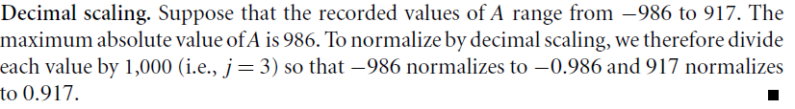
Data Transformation: Normalization
Normalization by decimal scaling
Where j is the smallest integer such that Max(|ν’|) < 1

Slide 43
Scatter plot
A scatter plot (or scatter diagram) is used to show the relationship between two variables
Correlation analysis is used to measure strength of the association (linear relationship) between two variables
The pattern of data is indicative of the type of relationship between your two variables:
  positive relationship
  negative relationship
  no relationship

Slide 44
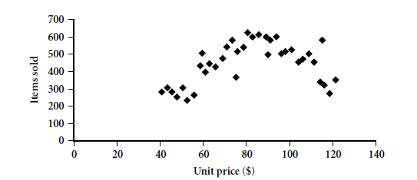
Scatter plot
Provides a first look at bivariate data to see clusters of points, outliers, etc
Each pair of values is treated as a pair of coordinates and plotted as points in the plane

Slide 45
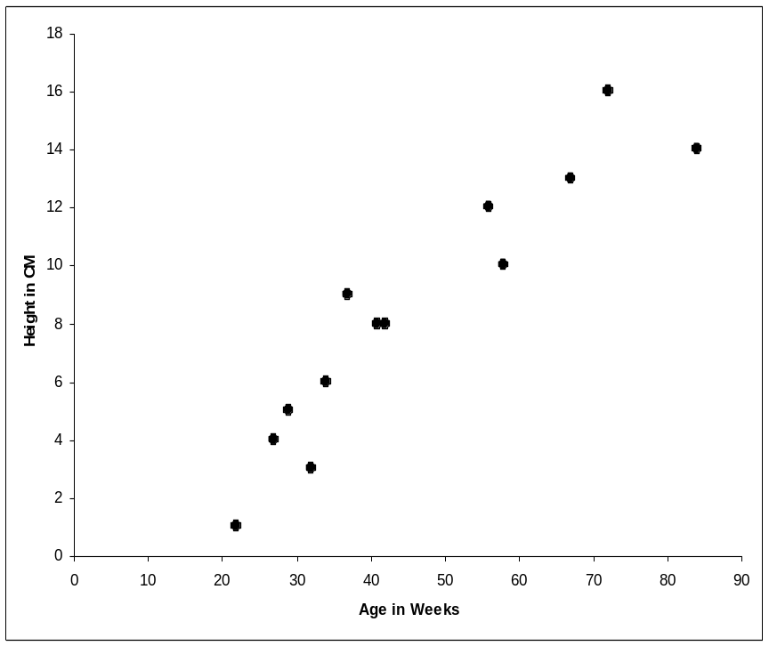
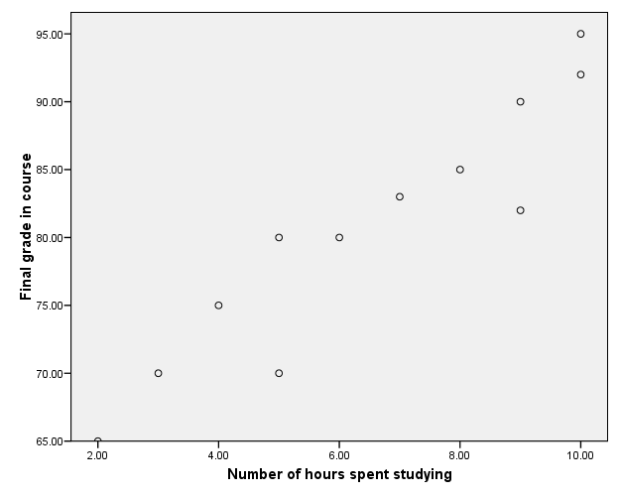
Positively and Negatively Correlated Data
Positive Correlation: The correlation is said to be positive correlation if the values of two variables changing with same direction. Example: Height & weight

Slide 46
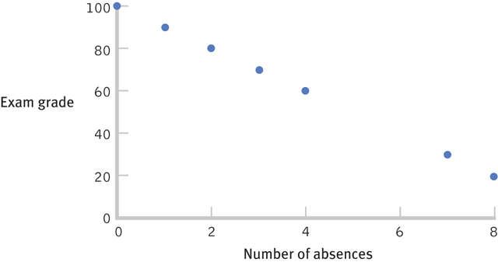
Positively and Negatively Correlated Data
Negative Correlation: The correlation is said to be negative correlation when the values of variables change with opposite direction.

Slide 47
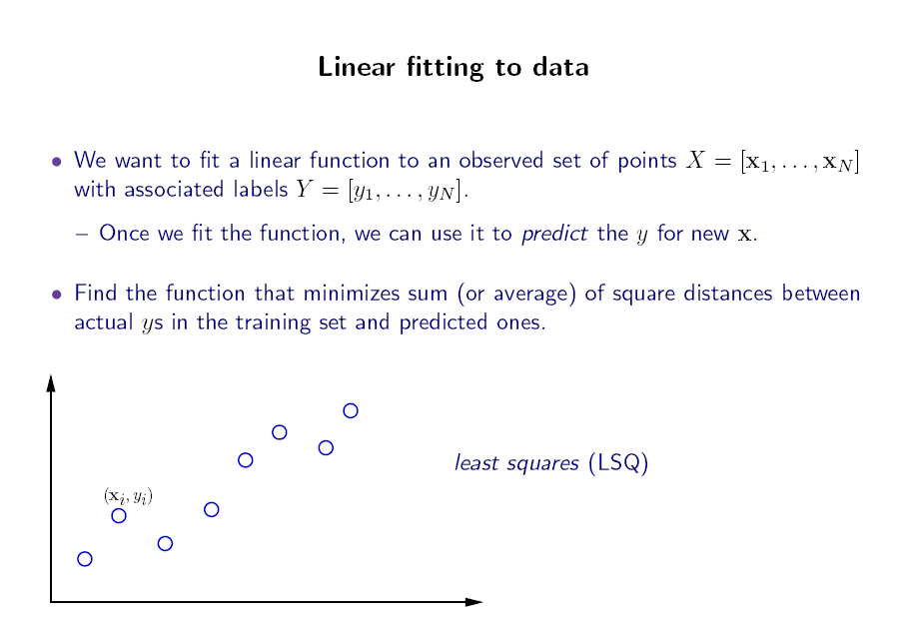


Slide 48
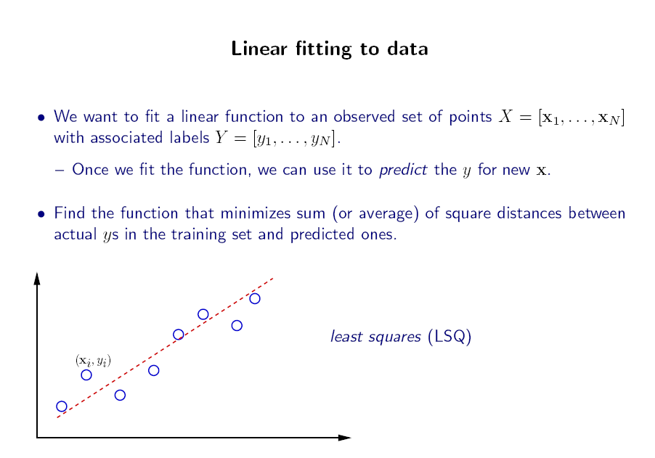

Slide 49
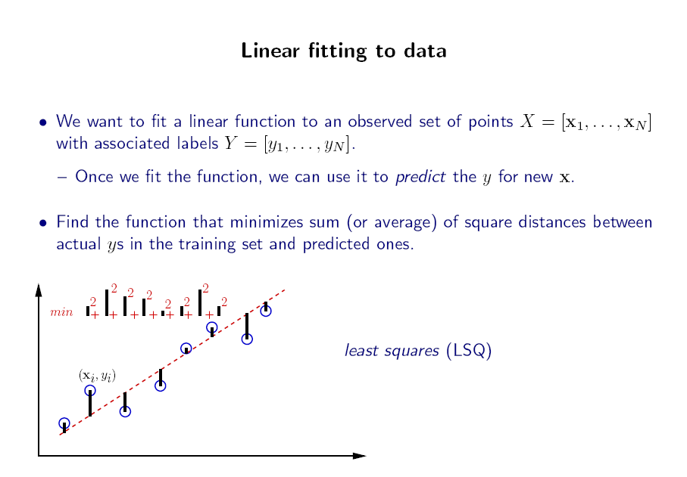

Slide 50
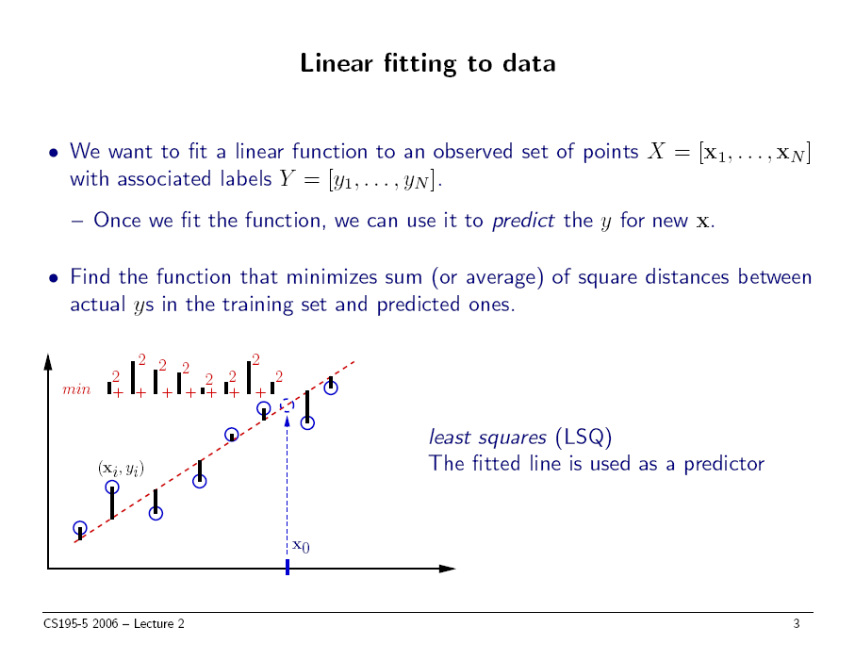
slide thanks to Greg Shakhnarovich (CS195-5, Brown Univ., 2006)

Slide 51
Linear Correlation
Linear relationships
Curvilinear relationships
Y
Y
X
X
Y
Y
X
X

Slide 52
Linear Correlation
Strong relationships
Weak relationships
Y
Y
X
X
Y
Y
X
X

Slide 53
Linear Correlation
No relationship
Y
X
Y
X

Slide 54

Correlation Coefficient “r”
A measure of the strength and direction of a linear relationship between two variables
The range of r is from –1 to 1.
–1
0
1
If r is close to –1 there is a strong negative correlation.
If r is close to 0 there is no linear correlation.
If r is close to 1 there is a strong positive correlation.
Notes:
Give several examples r = -0.97, r = 0.02 and ask for the strength of the correlation. For values like 0.63 a hypothesis test is necessary to determine whether it is strong or not.

Slide 55
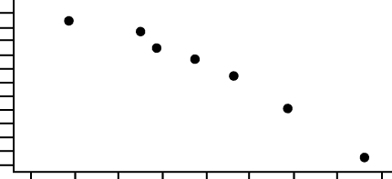
Application
Final
Grade
Absences
x y
8 78
2 92
5 90
12 58
15 43
9 74
6 81
95
90
85
80
75
Final Grade
70
65
60
55
50
45
40
0
2
4
6
8
10
12
14
16
Absences
X
Notes:
Ask students to identify the type of linear correlation described by the scatter plot.

Slide 56



Computation of r
x y
xy
x²
y²
1 8 78
2 2 92
3 5 90
4 12 58
5 15 43
6 9 74
7 6 81
624
184
450
696
645
666
486
64
4
25
144
225
81
36
6084
8464
8100
3364
1849
5476
6561
57
516
3751
579
39898
Notes:
The value or r that is computed represents the correlation coefficient of the sample. Have students interpret this result. Since r is close to -1, there is a strong negative correlation. As the number of absences increase, grades tend to decrease. Since there are 7 ordered pairs, n = 7.

Slide 57
Thank you

